Slide 1
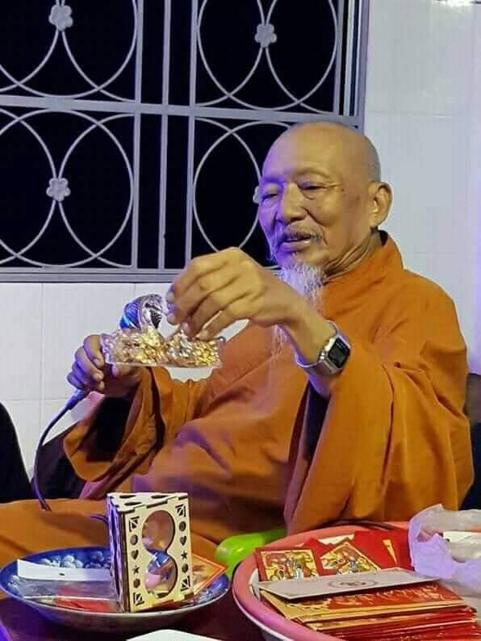
Group:
Master grandfather
Nguyễn Minh Quốc
Đỗ Phước Giang
Nguyễn Gia Khánh
Lê Văn Long

Slide 2
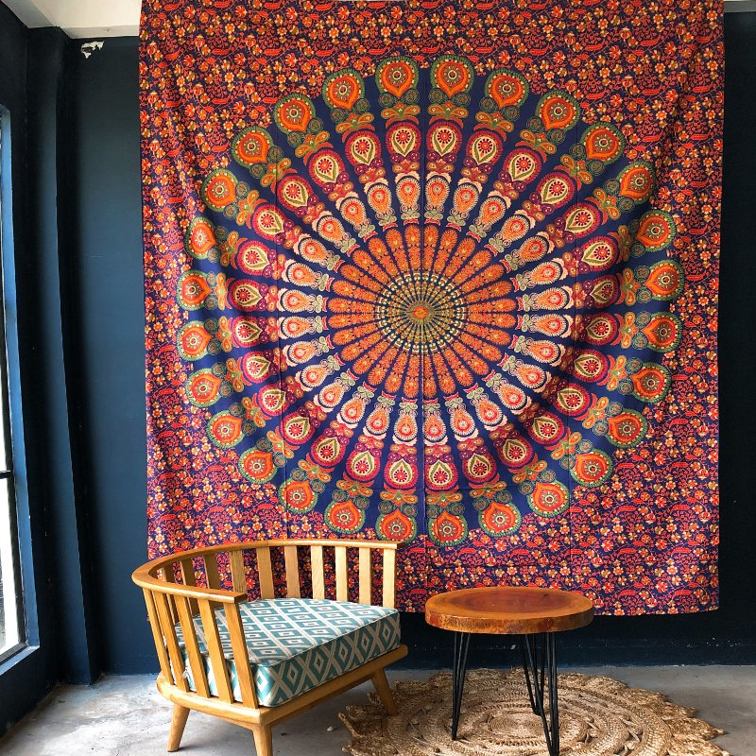
T
A
P
E
S
T
R
Y

Slide 3
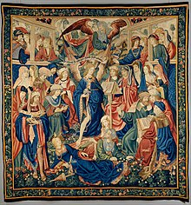
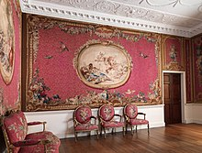
What is Tapestry?
Tapestry is a form of textile art, traditionally woven by hand on a loom. Tapestry is weft-faced weaving, in which all the warp threads are hidden in the completed work, unlike most woven textiles, where both the warp and the weft threads may be visible.

Slide 4
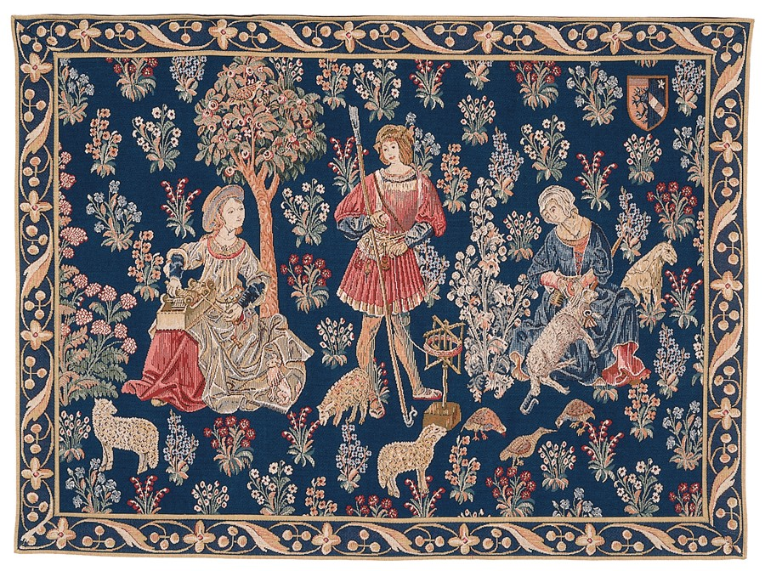
Origin
During the Middle Ages, art flourished and became inclusive of many elements, especially Christianity. Medieval art evolved from a mixture of German and Roman art, blending into the upheavals of the Middle Ages. The distinctive look and Gothic style of this art form is mainly related to its origins.

Slide 5
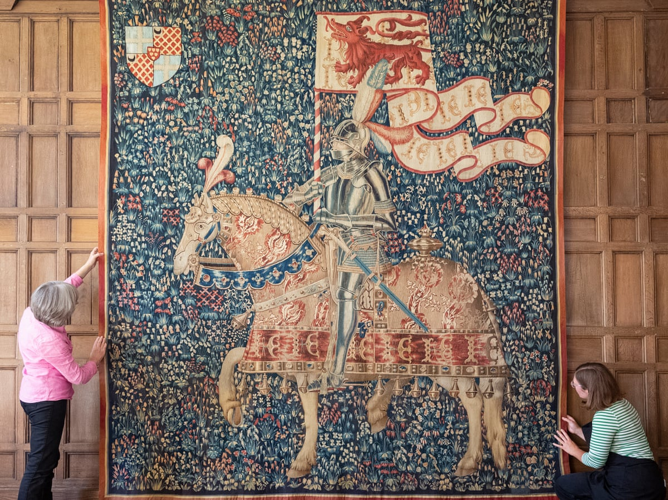
How are Tapestry made?
Decoration is a type of textile. A variety of frames can be used, including warp or "high warp" frames, where the rug is stretched in front of the weaver, or horizontal "low warp" frames, commonly found in large homes of the Middle Ages and the Renaissance.

Slide 6
Themes & styles
Hunting
Army
Millefleur style
View
The emergence of Renaissance style and theme
16th, 17th, 18th, 19th century
Outside of Europe

Slide 7
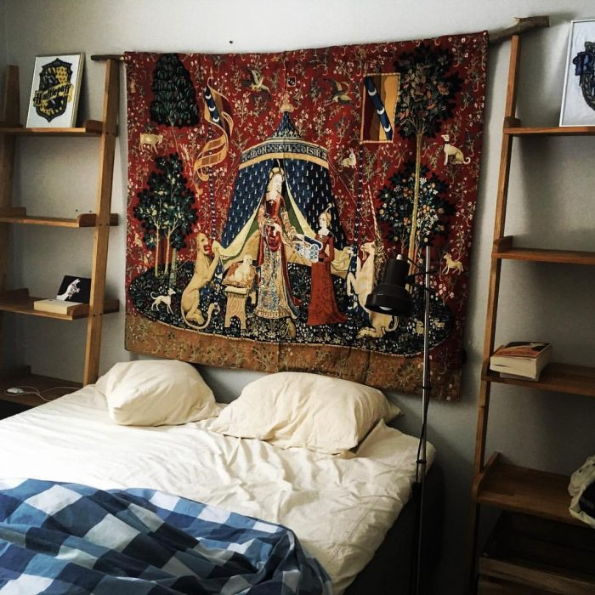
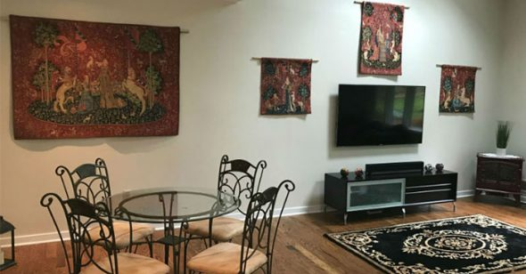
Uses of tapestry
Tapestry has many uses, but mainly people use tapestry such as:
- Decorative wall hanging
- Tablecloths
- Picnic blanket
- Hanging to the ceiling decoration
- Make window blinds
- Cover sofa

Slide 8
Benefit of tapestry
With that versatile use, Tapestry is currently very popular in many Western countries, especially Latin American countries
With compact, lightweight and easy to clean when dirty, Tapestry has now become a widespread decoration trend and has begun to be loved and trusted by many Vietnamese.

Slide 9
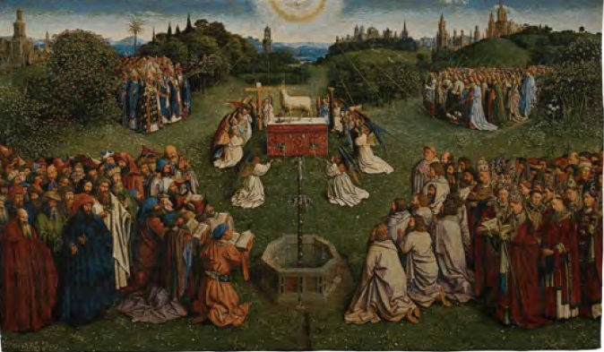
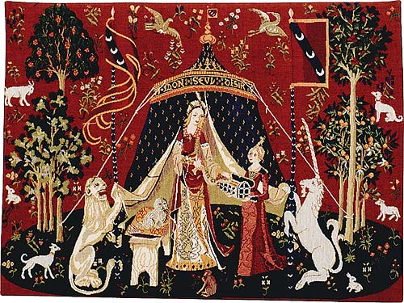
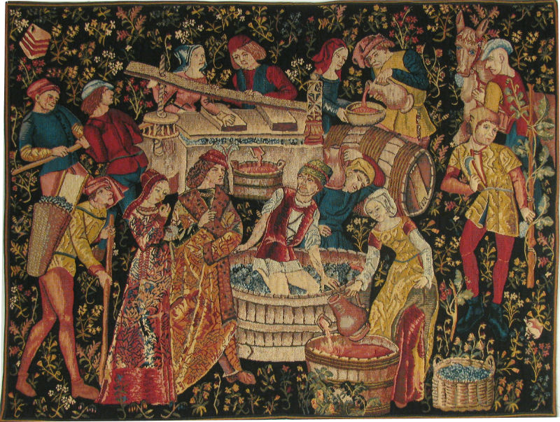
For example
Sheep sacrifice
Affection
Grape juice

Slide 10
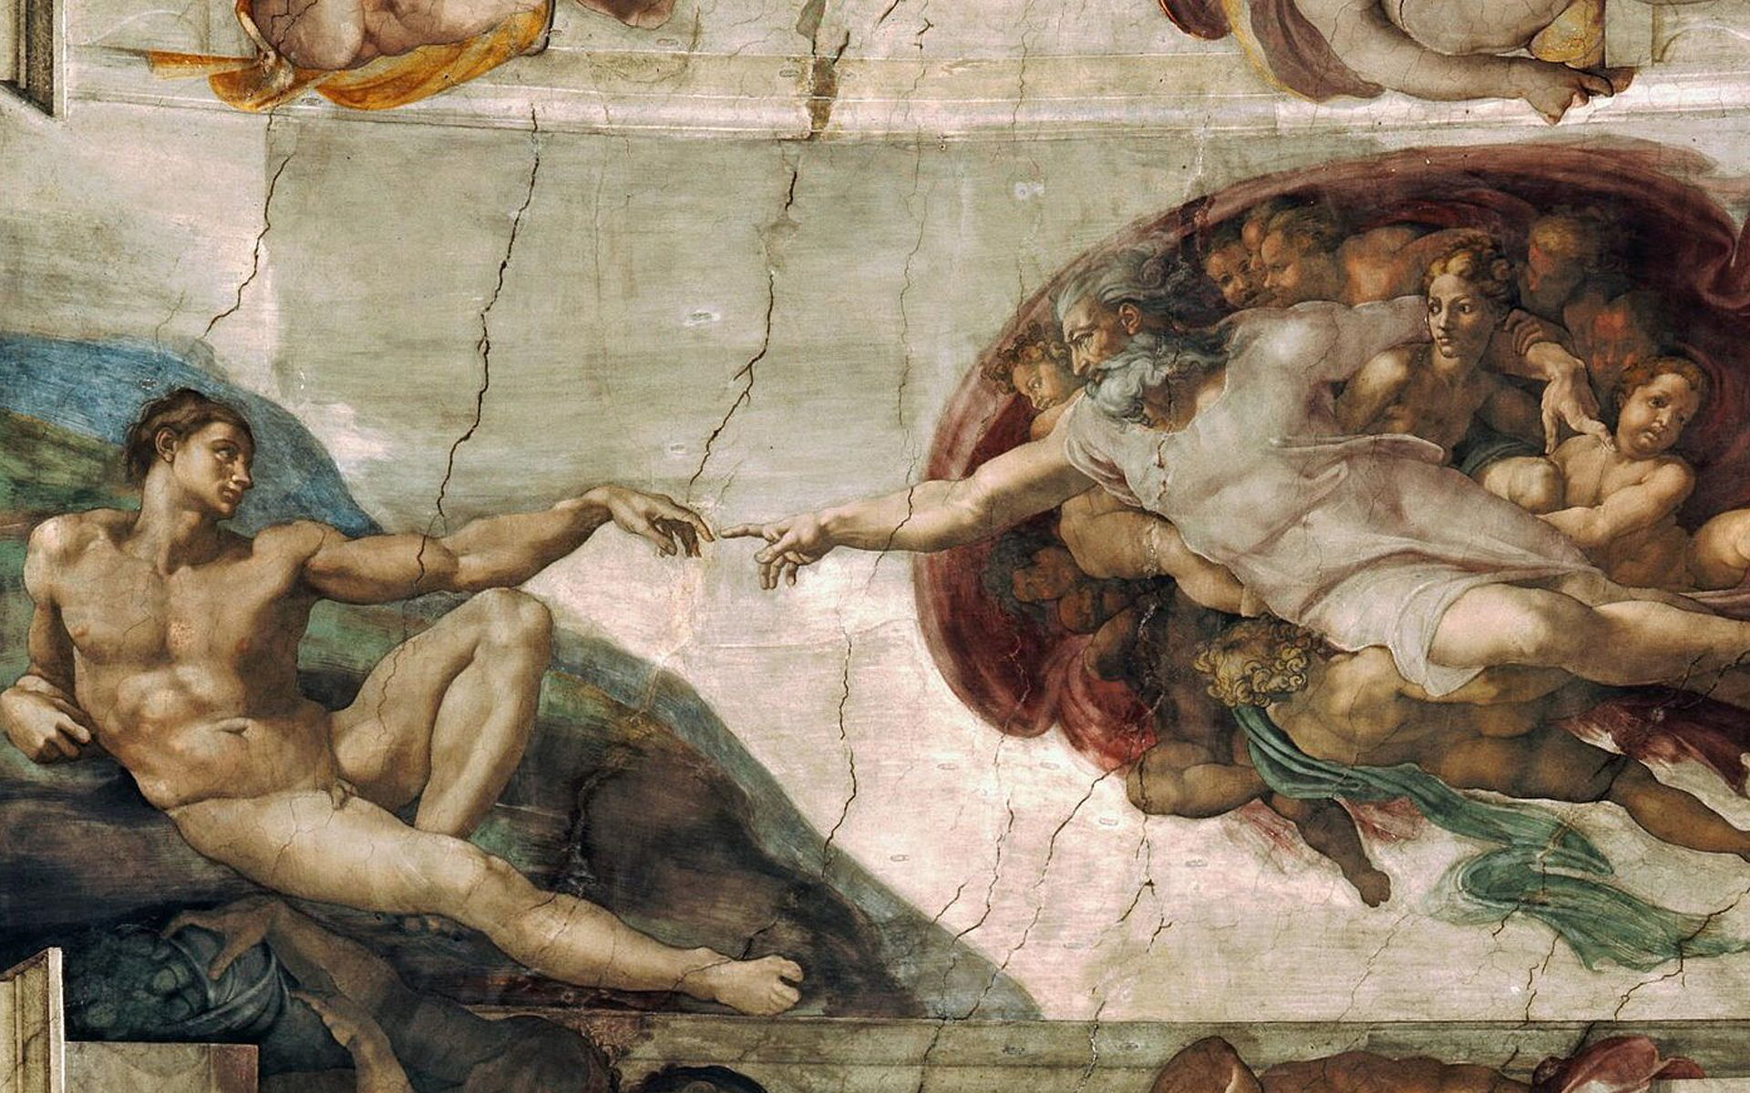
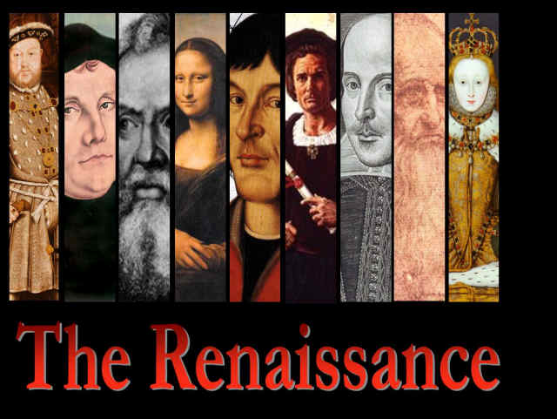

Slide 11
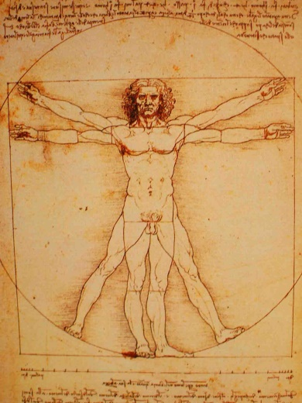
What is the renaissance?
The Renaissance was a cultural movement that profoundly influenced European intellectual life during the early modern period. Beginning in Italy and spreading to the rest of Europe in the 16th century, its influence has been felt in art, architecture, philosophy, literature, music, science and technology. , politics, religion and other aspects of intellectual inquiry.

Slide 12
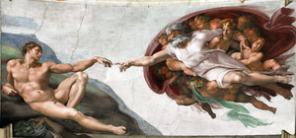
Origin
Many believe that the ideas describing the Renaissance originated in Florence in the early 13th and 14th centuries.
Others argue that the general competition between artists and many figures such as Brunelleschi and Ghiberti for art commissions was the source of Renaissance creativity.

Slide 13
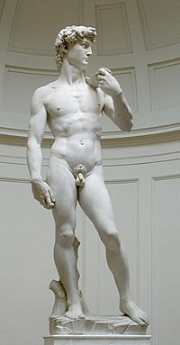
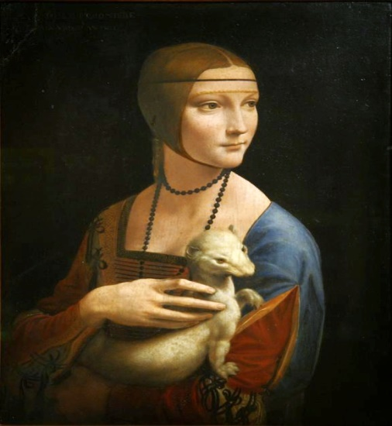
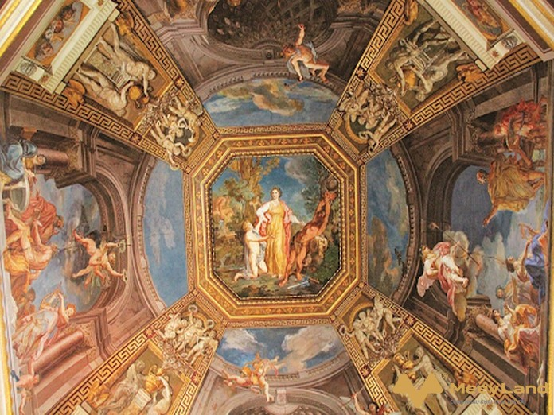
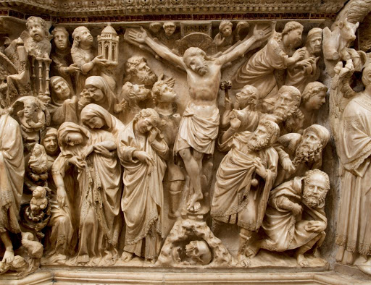
Characteristic of the renaissance period
Philosophy
Art
1, Art
2, Architecture
3, Sculpture
Non-visual art
1, Literary
2, Music
Science
Self-conscious
Religion

Slide 14
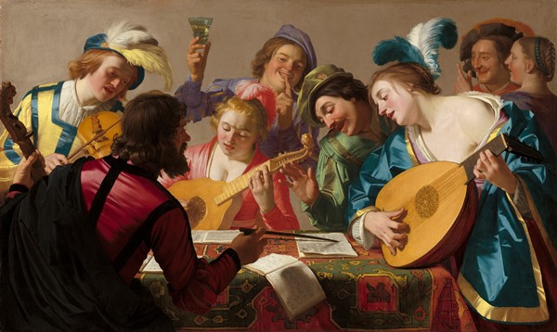
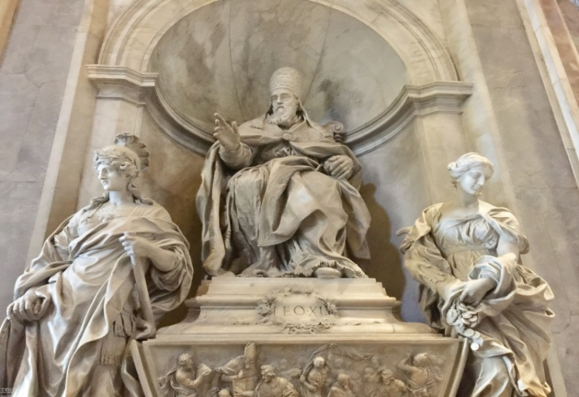
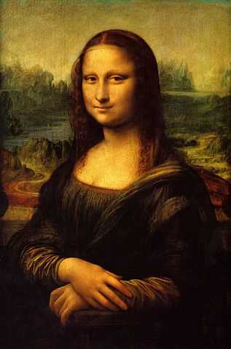
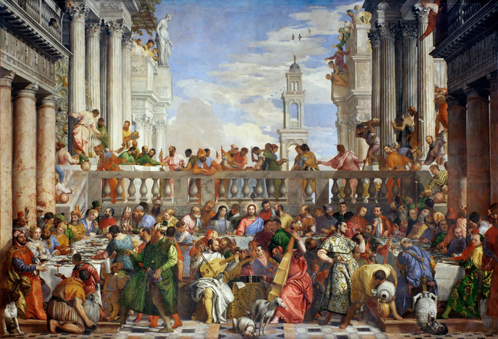
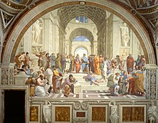
For example
renaissance music
renaissance sculpture
Mona lisa
renaissance painting
Athena School

Slide 15
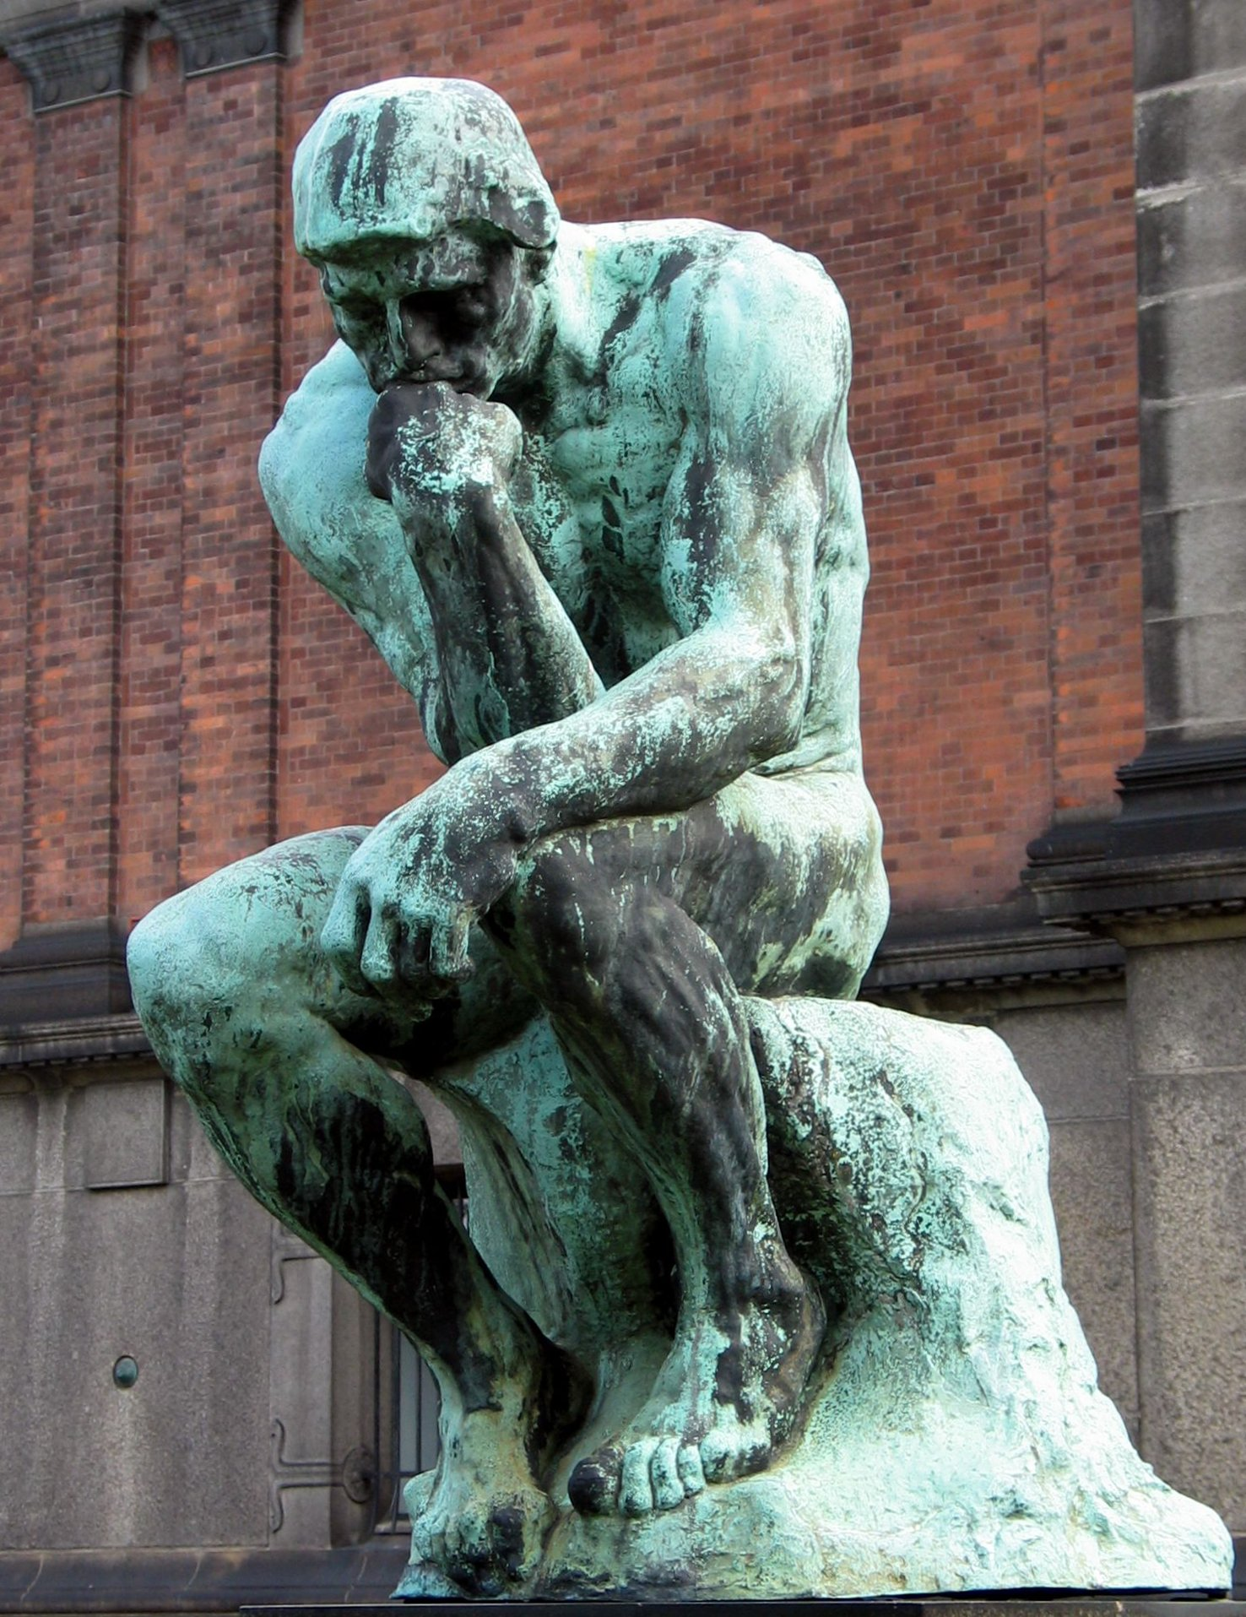
STATUE

Slide 16
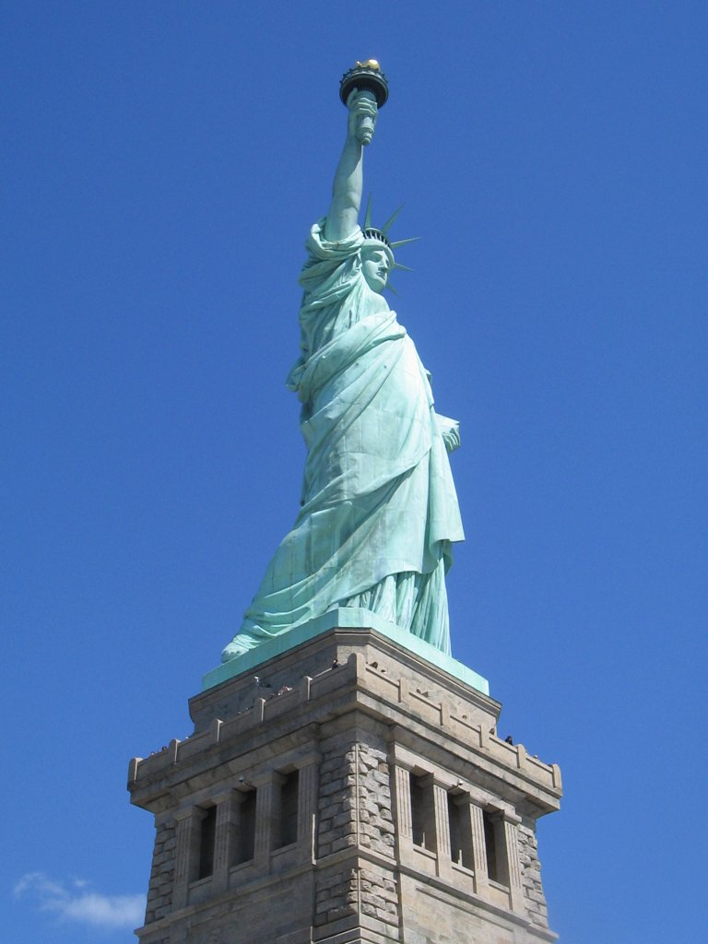
What is statue?
A statue is a sculpture intended to represent a person, an animal, or an event, usually made at life size or possibly larger as distinct from a bust.Main tool is to replace the real agent with representative properties.

Slide 17
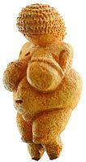
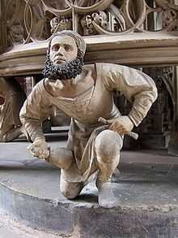
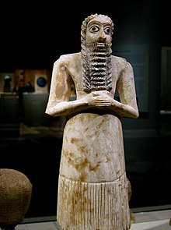
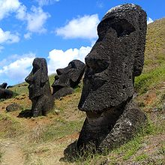
Origin
Prehistoric period
Europe
Ancient Near East
Material
stone
metal
glass
ceramic boat
woodcarving

Slide 18
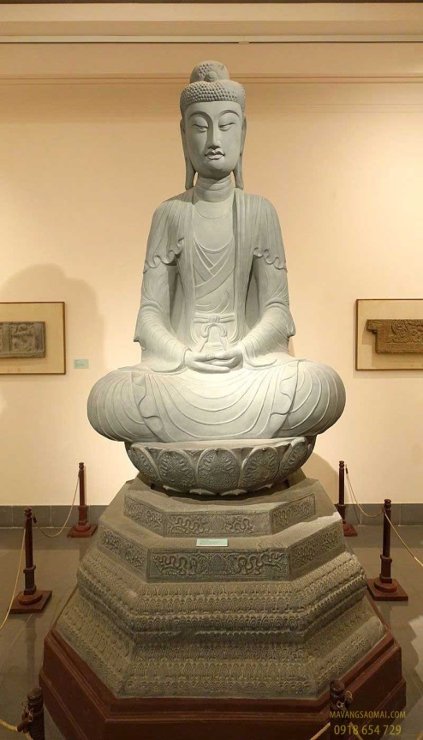
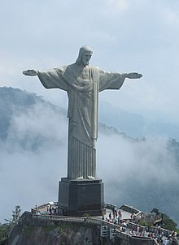
The statue was built for a purpose?
The statue is built to commemorate a historical event, or the life of an influential person in society. Many statues are considered public art, open-air exhibitions or in public buildings

Slide 19
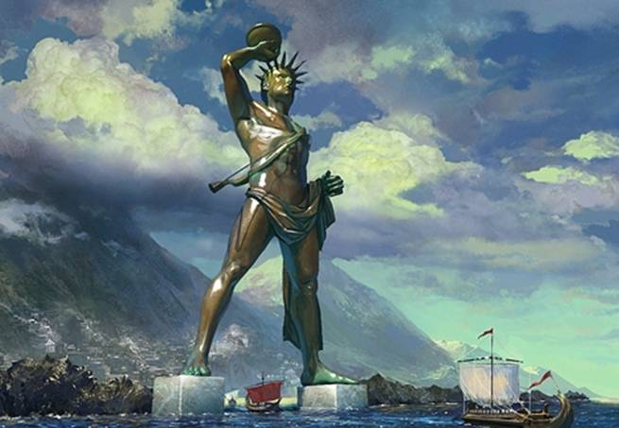
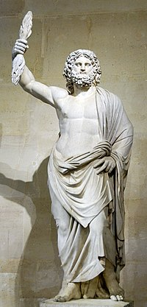
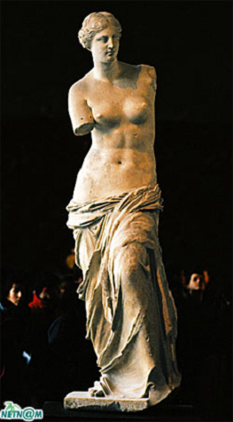
Many statues are among the wonders of the world, such as the "Colossus of Rhodes" and the Statue of Zeus at Olympia in the Seven Wonders of the Ancient World and the "Moai" on Easter Island among the wonders of the modern world. grand.

Slide 20
THANKS FOR LISTENING

